Slide 1
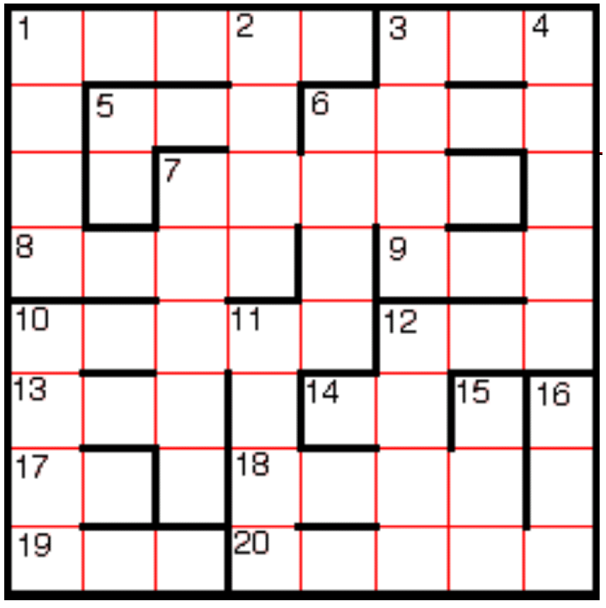
Calculator Crossword
Use a calculator to work out answers to the following questions and write down the answer as a number next to the question.
Then turn your calculator upside down and write down the answer as a word into the crossword grid.
Clues Across
1. 12 x 3 173
3. 7² x 13
5. 4² x 19
6. 1 777 x 4
7. 58 767 - 689
8. 1 421 x 5
9. 22² + 21
10. 11 547 x 5
12. 8³ + 2
13. 151 x 4
14. 7 ÷ 14
17. 2² + 6²
18. 2 572 x 3
19. 8³ + 5³ + 3³ - 1
20. 5 x 15 469
Clues Down
1. 758 x 7
2. 3 869 x 2
3. 1 682 + 4 125
4. 13 769 x 4
5. 7² - 15
6. 726 x 8
7. 3 338 x 11
10. 15³ - 330
11. 6 498 - 891
12. 60² + 10² + 2²
15. 25² + 11² + 5²
16. 621 + 112

Slide 2
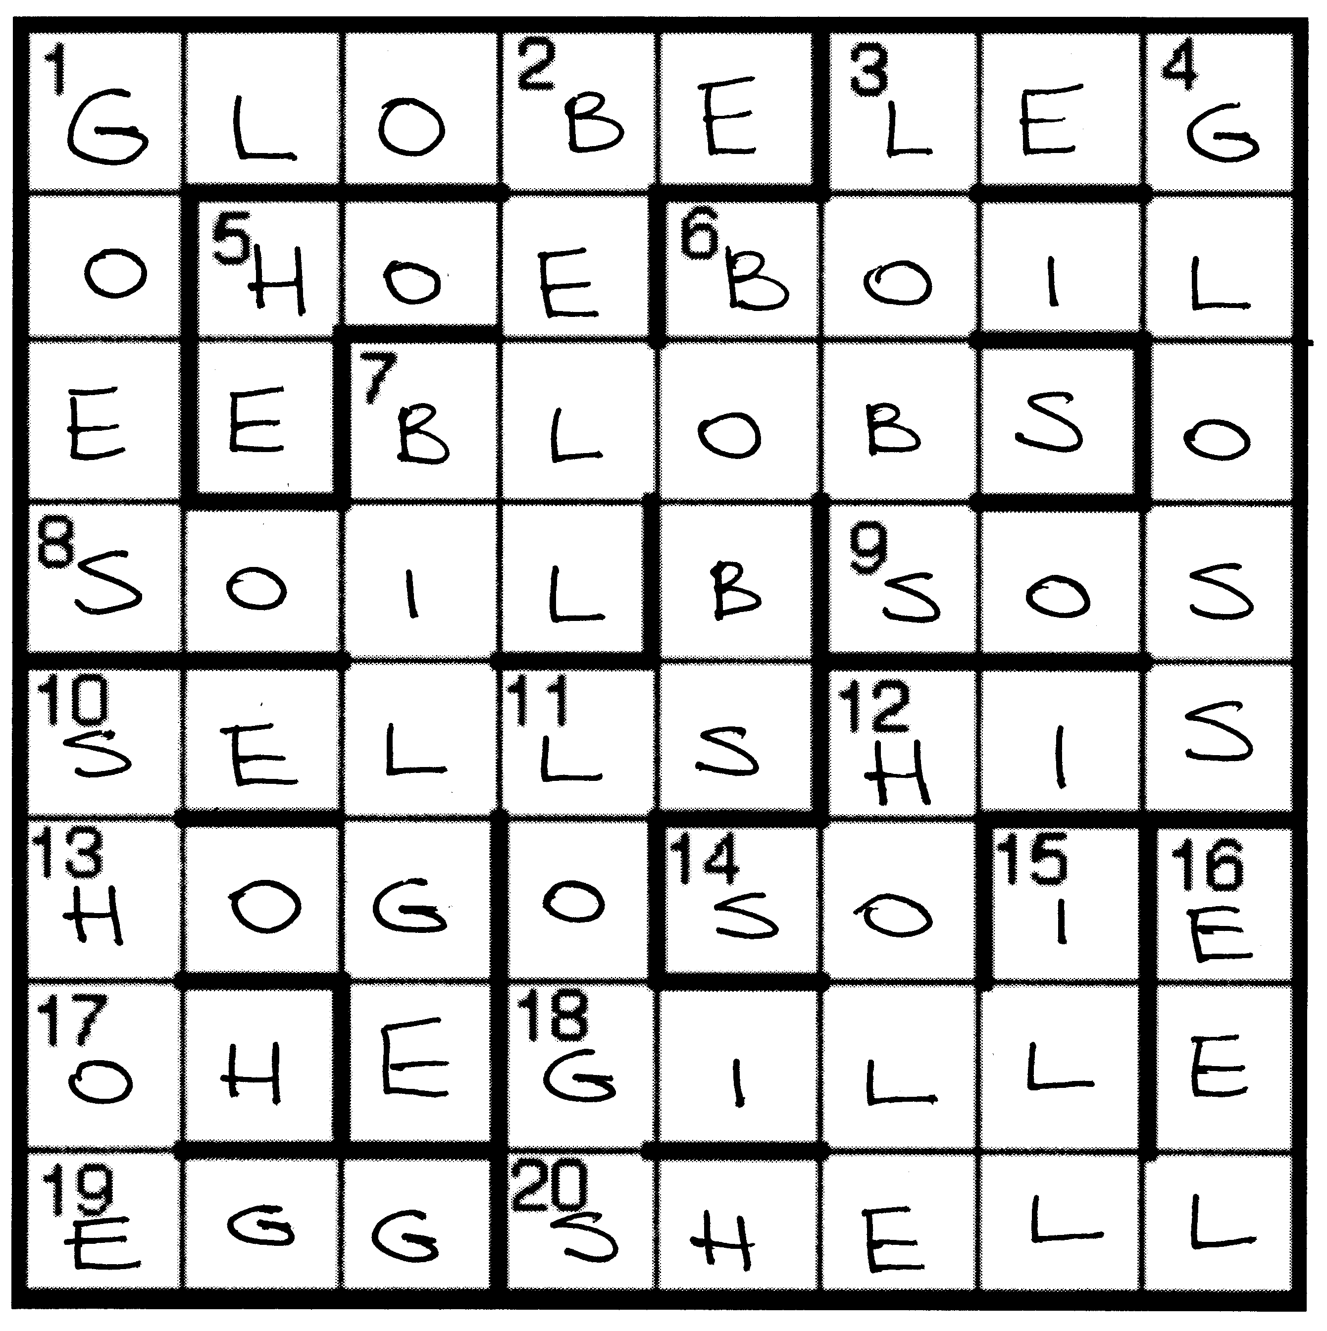
Calculator Crossword - Solution
Answers Across
1. 38 076
3. 637
5. 304
6. 7 108
7. 58 078
8. 7 105
9. 505
10. 57 735
12. 514
13. 604
14. 0.5
17. 40
18. 7 716
19. 663
20. 77 345
Answers Down
1. 5 306
2. 7 738
3. 5 807
4. 55 076
5. 34
6. 5 808
7. 36 718
10. 3 045
11. 5 607
12. 3 704
15. 771
16. 733

